Slide 1
Opening a new Vegetarian Indian Restaurant in Toronto

Slide 2
Importance of Restaurant Location
The location is highly determinant in the popularity as well as the success of the restaurant.
In our case, it is highly important that the restaurant is located in neighbourhoods which are already popular among visitors who prefer Indian Food

Slide 3
Data Acquisition Cleaning
Scraped of Toronto neighborhoods via Wikipedia
Obtained Latitude and Longitude data of the corresponding neighborhoods via Geocoder package
Used Foursquare API to get venue data related to these neighbourhoods.

Slide 4
Cluster Formation K-Means
The collected data is transformed so as to make it compatible with K-means algorithm requirements.
This data is the divided into 5 clusters as it provides the best performance

Slide 5
Cluster Details
Cluster 0: Neighborhoods with low popularity Indian Restaurants
Cluster 1: Neighborhoods with highly popular Indian Restaurants and Asian Cuisine Restaurants (Asian, Chinese & Thai)
Cluster 2: Neighborhoods with highly popular Indian Restaurants
Cluster 3: Neighborhoods with moderately - highly popular Indian Restaurants and highly popular Vegetarian Restaurants
Cluster 4: Neighborhoods with moderately popular Indian Restaurants

Slide 6
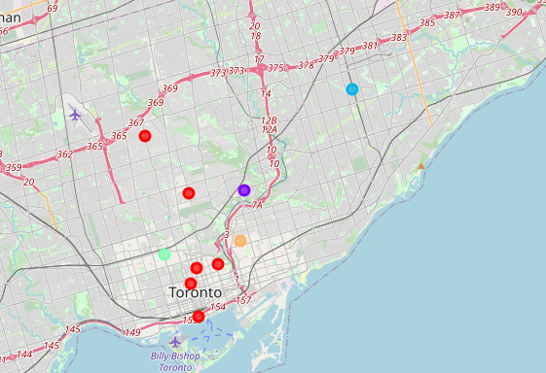
Cluster Mapping
Clusters obtained from the k-means algorithm are mapped.

Slide 7
Reccomendations
The ideal location for Veg Indian restaurants will be in Cluster 3 (The Annex, North Midtown, Yorkville) as it provides plenty of visitors interested in both Veg food as well as Indian food.
There are good opportunities to open in Cluster 1 (Thorncliffe Park) and Cluster 2 (Dorset Park, Wexford Heights, Scarborough Town Centre).

Slide 8
Conclusions and Future Decisions
Performed machine learning by utilizing k-means clustering algorithm and provided recommendations to the stakeholder
In the future, the model can also incorporate demographic details of the population in neighbourhoods
Thus the restaurants can be opened where high number of target demographic resides

Slide 9
THANKS

